Slide 1
CSL718 : Architecture of
High Performance Systems
Introduction
9th January, 2006

Slide 2
High Performance Architectures
Who needs high performance systems?
How do you achieve high performance?
How to analyse or evaluate performance?

Slide 3
Outline
Classification
ILP Architectures
Data Parallel Architectures
Process level Parallel Architectures
Issues in parallel architectures
Cache coherence problem
Interconnection networks

Slide 4
Outline
Classification
ILP Architectures
Data Parallel Architectures
Process level Parallel Architectures
Issues in parallel architectures
Cache coherence problem
Interconnection networks
Flynn’s [66]
Feng’s [72]
Händler’s [77]
Modern (Sima, Fountain & Kacsuk)

Slide 5
Flynn’s Classification
Architecture Categories
SISD
SIMD
MISD
MIMD

Slide 6
SISD
IS
C
IS
P
DS
M

Slide 7
SIMD
P
DS
M
IS
C
P
DS

Slide 8
MISD
IS
C
IS
P
DS
M
IS
C
IS
P
DS

Slide 9
MIMD
IS
C
IS
P
DS
M
IS
C
IS
P
DS

Slide 10
Feng’s Classification
16K
MPP
256
STARAN
PEPE
bit slice
length
IlliacIV
64
16
C.mmP
1
PDP11
IBM370
CRAY-1
1
16
32
64
word length

Slide 11
Händler’s Classification
< K x K’ , D x D’ , W x W’ >
control data word
dash → degree of pipelining
TI - ASC <1, 4, 64 x 8>
CDC 6600 <1, 1 x 10, 60> x <10, 1, 12> (I/O)
C.mmP <16,1,16> + <1x16,1,16> + <1,16,16>
PEPE <1 x 3, 288, 32>
Cray-1 <1, 12 x 8, 64 x (1 ~ 14)>

Slide 12
Modern Classification
Parallel architectures
Data-parallel
architectures
Function-parallel
architectures

Slide 13
Data Parallel Architectures
Data-parallel
architectures
Vector
architectures
Associative
And neural
architectures
SIMDs
Systolic
architectures

Slide 14
Function Parallel Architectures
Function-parallel architectures
Instr level Parallel Arch
Thread level Parallel Arch
Process level Parallel Arch
(ILPs)
(MIMDs)
Pipelined processors
VLIWs
Superscalar processors
Distributed Memory MIMD
Shared Memory MIMD

Slide 15
Outline
Classification
ILP Architectures
Data Parallel Architectures
Process level Parallel Architectures
Issues in parallel architectures
Cache coherence problem
Interconnection networks
Pipelining
VLIW
Superscalar

Slide 16
Pipelining
Simple multicycle design :
resource sharing across cycles
all instructions may not take same cycles
IF D RF EX/AG M WB
faster throughput with pipelining

Slide 17
Hazards in Pipelining
Procedural dependencies => Control hazards
  conditional and unconditional branches, calls/returns
Data dependencies => Data hazards
  RAW (read after write)
  WAR (write after read)
  WAW (write after write)
Resource conflicts => Structural hazards
  use of same resource in different stages

Slide 18
Pipeline Performance
T
S stages
Frequency of interruptions - b
CPI = 1 + (S - 1) * b
Time = CPI * T / S

Slide 19
ILP in VLIW processors
Cache/
memory
Fetch
Unit
Single multi-operation instruction
FU
FU
FU
Register file
multi-operation instruction

Slide 20
ILP in Superscalar processors
Decode
and issue
unit
Cache/
memory
Fetch
Unit
Multiple instruction
FU
FU
FU
Sequential stream of instructions
Instruction/control
Data
Register file
FU
Funtional Unit

Slide 21
Why Superscalars are popular ?
Binary code compatibility among scalar & superscalar processors of same family
Same compiler works for all processors (scalars and superscalars) of same family
Assembly programming of VLIWs is tedious
Code density in VLIWs is very poor - Instruction encoding schemes

Slide 22
Issues in VLIW Architecture
FU
FU
FU
Register file
Instruction encoding
Scalability: Access time, area, power consumption sharply increase with number of register ports

Slide 23
Tasks of superscalar processing
Parallel Superscalar Parallel Preserving the Preserving the
decoding instruction instruction sequential sequential
issue execution consistency of consistency of
execution exception
processing

Slide 24
Outline
Classification
ILP Architectures
Data Parallel Architectures
Process level Parallel Architectures
Issues in parallel architectures
Cache coherence problem
Interconnection networks
SIMD Processors
Vector Processors
Associative Processors
Systolic Arrays

Slide 25
Data Parallel Architectures
SIMD Processors
  Multiple processing elements driven by a single instruction stream
Vector Processors
  Uni-processors with vector instructions
Associative Processors
  SIMD like processors with associative memory
Systolic Arrays
  Application specific VLSI structures

Slide 26
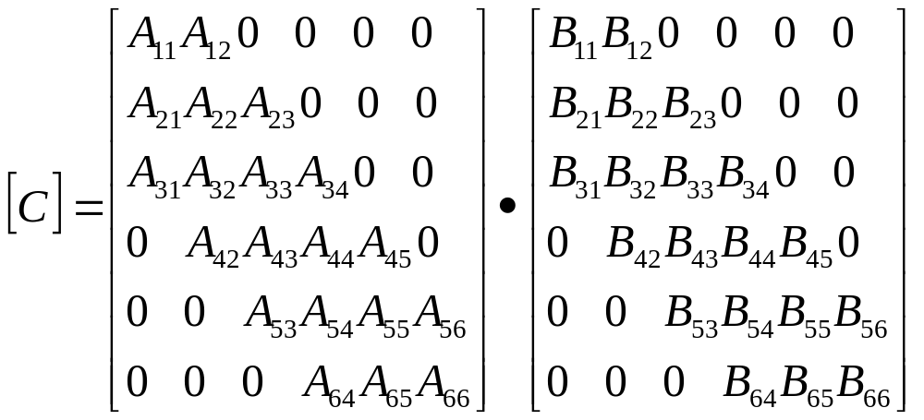
Systolic Arrays [H.T. Kung 1978]
Simplicity, Regularity, Concurrency, Communication
Example :
Band matrix multiplication

Slide 27
T=0
A₂₃
B₃₁
A₂₂
A₁₂
B₂₁
A₃₁
A₂₁
A₁₁
B₁₁
B₁₂

Slide 28
Outline
Classification
ILP Architectures
Data Parallel Architectures
Process level Parallel Architectures
Issues in parallel architectures
Cache coherence problem
Interconnection networks
MIMD Processors
  - Shared Memory
  - Distributed Memory

Slide 29
Why Process level Parallel Architectures?
Data-parallel architectures
Function-parallel architectures
Instruction level PAs
Thread level PAs
Process level PAs
(MIMDs)
Built using
general purpose
processors
Distributed Memory MIMD
Shared Memory MIMD

Slide 30
MIMD Architectures
Design Space
Extent of address space sharing
Location of memory modules
Uniformity of memory access

Slide 31
Outline
Classification
ILP Architectures
Data Parallel Architectures
Process level Parallel Architectures
Issues in parallel architectures
Cache coherence problem
Interconnection networks
User’s perspective
Architect’s perspective

Slide 32
Issues from user’s perspective
Specification / Program design
  explicit parallelism or
  implicit parallelism + parallelizing compiler
Partitioning / mapping to processors
Scheduling / mapping to time instants
  static or dynamic
Communication and Synchronization

Slide 33
Parallel programming models
Concurrent control flow
Functional or logic program
Vector/array operations
Concurrent tasks/processes/threads/objects
With shared variables or message passing
Relationship between programming model and architecture ?

Slide 34
Issues from architect’s perspective
Coherence problem in shared memory with caches
Efficient interconnection networks

Slide 35
Outline
Classification
ILP Architectures
Data Parallel Architectures
Process level Parallel Architectures
Issues in parallel architectures
Cache coherence problem
Interconnection networks
Coherence Protocols
  - Bus or directory based
  - Invalidate or update
  - Definition of states

Slide 36
Cache Coherence Problem
Multiple copies of data may exist
⇒ Problem of cache coherence
Options for coherence protocols
What action is taken?
  Invalidate or Update
Which processors/caches communicate?
  Snoopy (broadcast) or directory based
Status of each block?

Slide 37
Outline
Classification
ILP Architectures
Data Parallel Architectures
Process level Parallel Architectures
Issues in parallel architectures
Cache coherence problem
Interconnection networks
Switching and control
Topology

Slide 38
Interconnection Networks
Architectural Variations:
  Topology
  Direct or Indirect (through switches)
  Static (fixed connections) or Dynamic (connections established as required)
  Routing type store and forward/worm hole)
Efficiency:
  Delay
  Bandwidth
  Cost

Slide 39
Books
D. Sima, T. Fountain, P. Kacsuk, "Advanced Computer Architectures : A Design Space Approach", Addison Wesley, 1997.
M.J. Flynn, "Computer Architecture : Pipelined and Parallel Processor Design", Narosa Publishing House/ Jones and Bartlett, 1996.
D.A. Patterson, J.L. Hennessy, "Computer Architecture : A Quantitative Approach", Morgan Kaufmann Publishers, 2002.
K. Hwang, "Advanced Computer Architecture : Parallelism, Scalability, Programmability", McGraw Hill, 1993.
H.G. Cragon, "Memory Systems and Pipelined Processors", Narosa Publishing House/ Jones and Bartlett, 1998.
D.E. Culler, J.P Singh and Anoop Gupta, "Parallel Computer Architecture, A Hardware/Software Approach", Harcourt Asia / Morgan Kaufmann Publishers, 2000.

